Slide 1
Restoration and development of Arm's Java-based LEGv8 ISA simulator
Graduating student - Simone Deiana
Supervisor - Alberto Carini
Department of Engineering and Architecture
Trieste, 10 September 2024

Slide 2
INTRODUCTION
Restoration and development of
Arm's Java-based LEGv8 ISA simulator​

Slide 3
INTRODUCTION
Restoration and development of
Arm's Java-based LEGv8 ISA simulator​

Slide 4
INTRODUCTION
Restoration and development of
Arm's Java-based LEGv8 ISA simulator​

Slide 5
WHAT IS LEGv8?
Restoration and development of
Arm's Java-based LEGv8 ISA simulator​

Slide 6



WHAT IS LEGv8?
AN ISA FOR LEARNING COMPUTER ARCHITECTURES
David A. Patterson
Peg Skorpinski, CC BY-SA 3.0 <https://creativecommons.org/licenses/by-sa/3.0>, via Wikimedia Commons
John L. Hennessy
Eric Chan, CC BY 2.0 <https://creativecommons.org/licenses/by/2.0>, via Wikimedia Commons
From Computer Organization and Design ARM Edition: The Hardware Software Interface - Patterson, D.A. and Hennessy, J.L.

Slide 7
WHAT IS LEGv8?
THE DESIGN PHILOSOPHY
As simple as it can be...
… but with a modern design
Heavily inspired by ARMv8, almost a "subset"

Slide 8
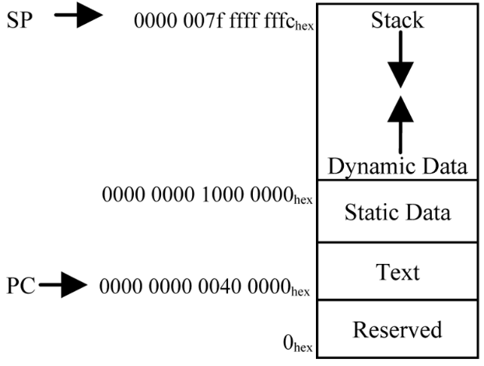
WHAT IS LEGv8?
THE MEMORY
64-bit addresses
Harvard model

Slide 9
WHAT IS LEGv8?
THE REGISTERS
32 64-bit "X" integer registers
32 64-bit "D" floating-point registers
32 32-bit "S" floating-point "registers"

Slide 10
WHAT IS LEGv8?
THE INSTRUCTIONS
64-bit integer and IEEE-754 floating-point arithmetic
Designed and optimized for pipelined execution

Slide 11
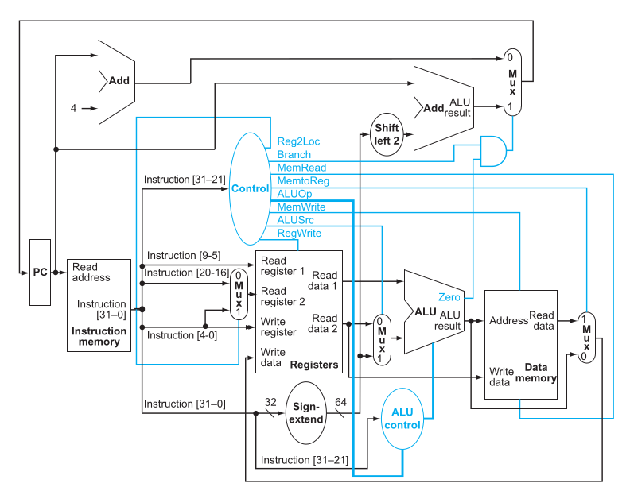
WHAT IS LEGv8?
THE DATAPATH
From Computer Organization and Design ARM Edition: The Hardware Software Interface - Patterson, D.A. and Hennessy, J.L.

Slide 12
WHAT IS LEGv8?
THE DATAPAH
INSTRUCTION MEMORY
From Computer Organization and Design ARM Edition: The Hardware Software Interface - Patterson, D.A. and Hennessy, J.L.

Slide 13
WHAT IS LEGv8?
THE DATAPATH
REGISTERS AND CONTROL UNIT
From Computer Organization and Design ARM Edition: The Hardware Software Interface - Patterson, D.A. and Hennessy, J.L.

Slide 14
WHAT IS LEGv8?
THE DATAPATH
ALU
From Computer Organization and Design ARM Edition: The Hardware Software Interface - Patterson, D.A. and Hennessy, J.L.

Slide 15
WHAT IS LEGv8?
THE DATAPATH
DATA MEMORY
From Computer Organization and Design ARM Edition: The Hardware Software Interface - Patterson, D.A. and Hennessy, J.L.

Slide 16
WHAT SIMULATOR, AND WHY?
Restoration and development of
Arm's Java-based LEGv8 ISA simulator

Slide 17

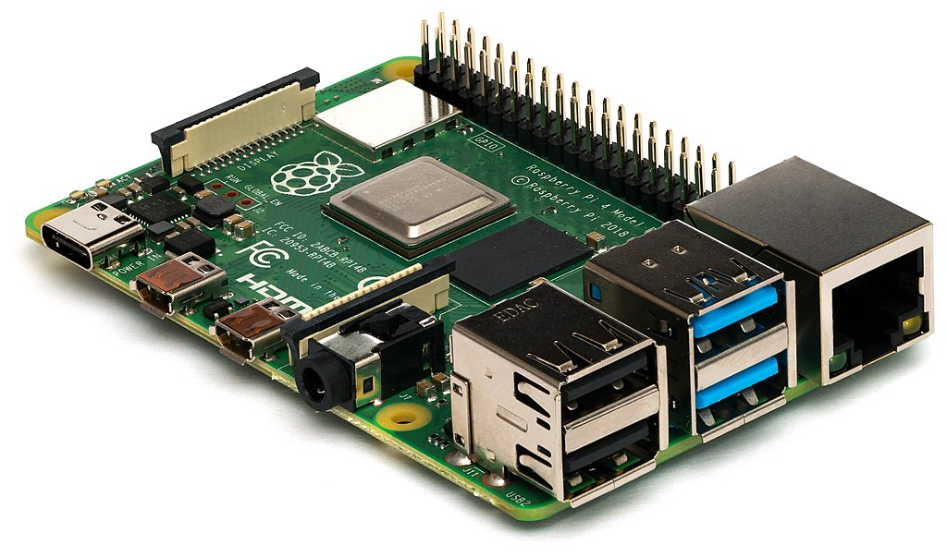
WHAT SIMULATOR, AND WHY?
NO HARDWARE FOR LEGv8 => NEED A SIMULATOR
Michael H. („Laserlicht“) / Wikimedia Commons

Slide 18
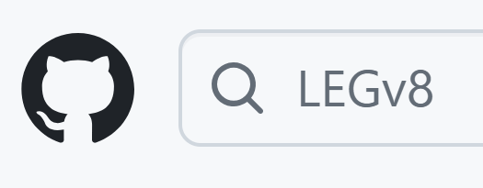
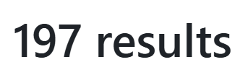
WHAT SIMULATOR, AND WHY?
BUT WHICH ONE?

Slide 19
WHAT SIMULATOR, AND WHY?
THE PROBLEM:
NO SOFTWARE CAN YET SIMULATE THE ENTIRE LEGv8 ISA!

Slide 20
WHAT SIMULATOR, AND WHY?
THE SOLUTION:
Write one from scratch
OR (BETTER)​
Improve one that already exists

Slide 21
WHAT SIMULATOR, AND WHY?
THE GOOD NEWS
ARM HAS OFFICIALLY MADE A LEGv8 SIMULATOR

Slide 22
WHAT SIMULATOR, AND WHY?
WHAT STANDS OUT:
Written in Java (high level, extensible)
Distributed as a web application
Nice, functional UI
Closely follows the textbook

Slide 23
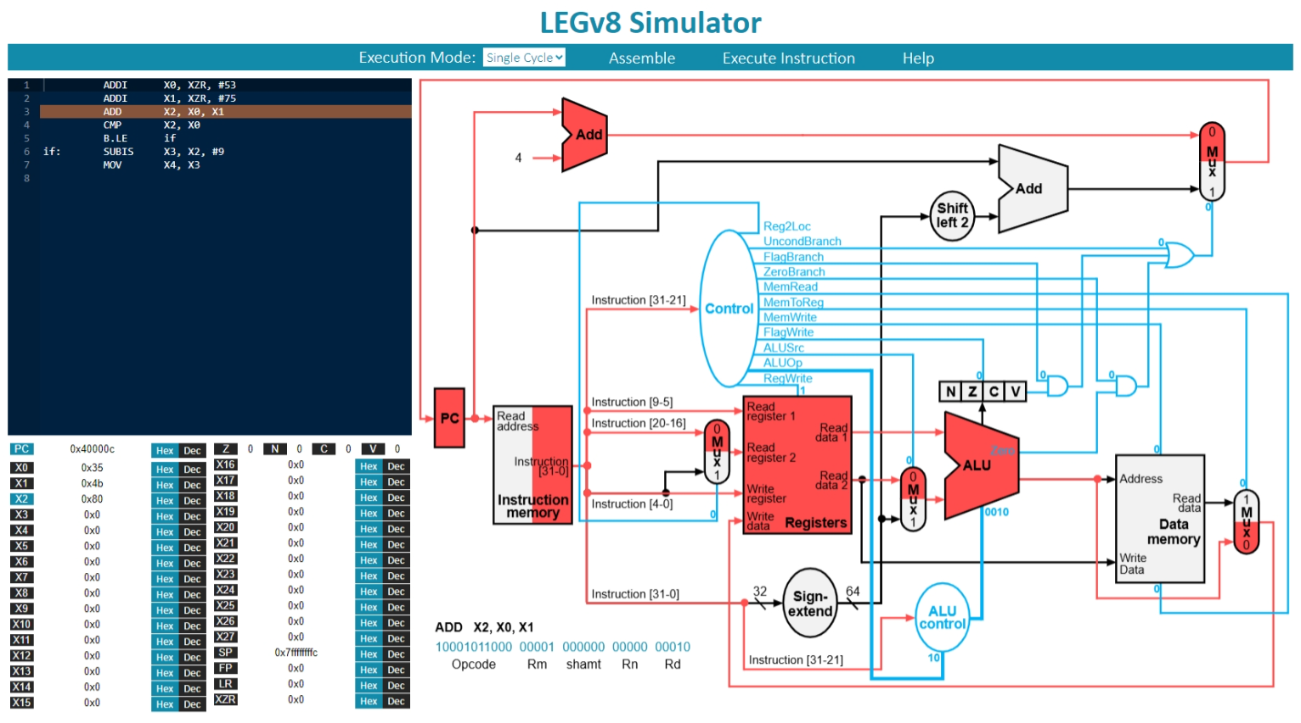
WHAT SIMULATOR, AND WHY?

Slide 24
FIXING AND RESTORING THE SIMULATOR
STRUCTURE OF THE SIMULATOR
EXECUTION MODE
CODE PARSER/LEXER
INSTRUCTION
CPU
MEMORY

Slide 25
WHAT SIMULATOR, AND WHY?
THE BAD NEWS
IT'S INCOMPLETE
AND BROKEN

Slide 26
FIXING AND RESTORING
THE SIMULATOR
Restoration and development of
Arm's Java-based LEGv8 ISA simulator​

Slide 27
FIXING AND RESTORING THE SIMULATOR
COMPARISONS DON'T WORK!
No "if-else" conditionals
No "switch-case" conditionals
No "while" loops
No "for" loops

Slide 28
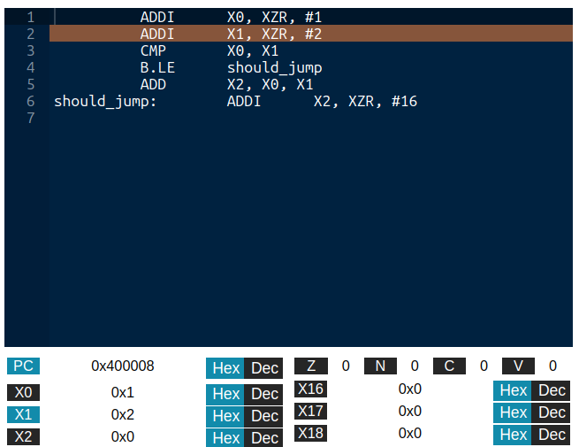
FIXING AND RESTORING THE SIMULATOR
THE COMPARISON BUG
X0 = 1, X1 = 2

Slide 29
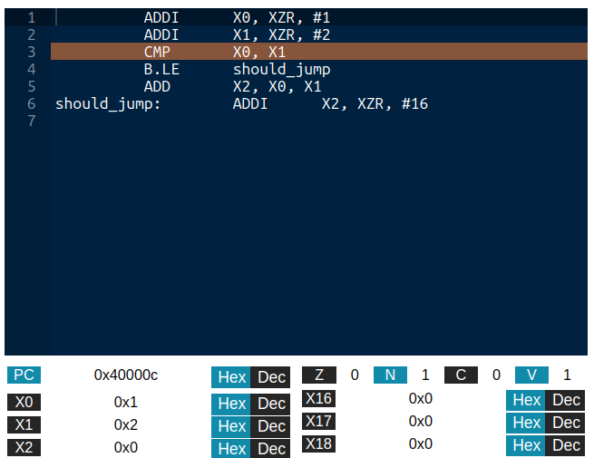
FIXING AND RESTORING THE SIMULATOR
THE COMPARISON BUG
COMPARE X0 WITH X1

Slide 30
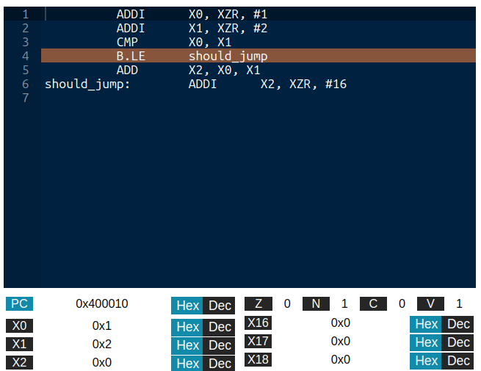
FIXING AND RESTORING THE SIMULATOR
THE COMPARISON BUG
1 <= 2 ?
OF COURSE, LET'S JUMP!

Slide 31
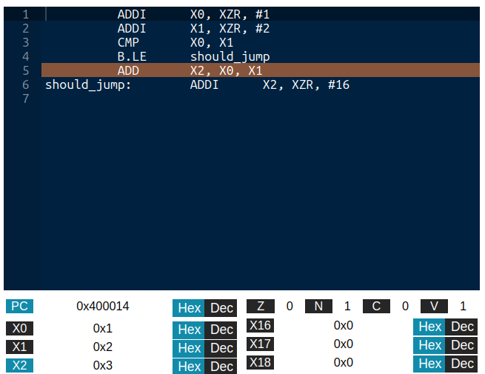
FIXING AND RESTORING THE SIMULATOR
THE COMPARISON BUG
...OR NOT

Slide 32
FIXING AND RESTORING THE SIMULATOR
BRANCH AND LINKS DON'T WORK!
void subroutine(arg1, ...)
float function(arg1, ...)
CAN'T REUSE CODE

Slide 33
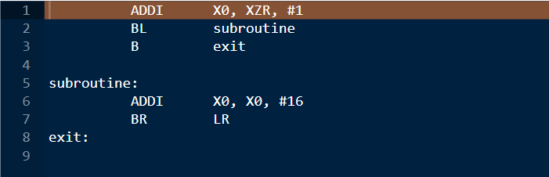
FIXING AND RESTORING THE SIMULATOR
THE BRANCH AND LINK BUG

Slide 34
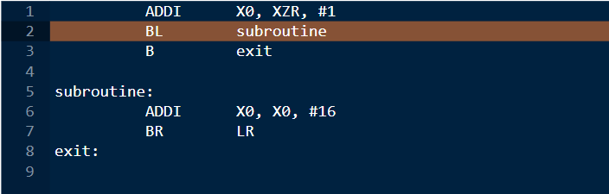
FIXING AND RESTORING THE SIMULATOR
THE BRANCH AND LINK BUG

Slide 35
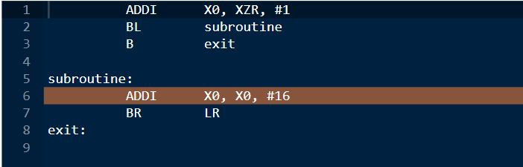
FIXING AND RESTORING THE SIMULATOR
THE BRANCH AND LINK BUG

Slide 36
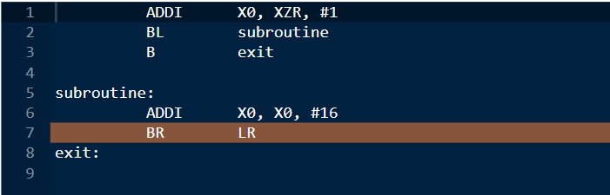
FIXING AND RESTORING THE SIMULATOR
THE BRANCH AND LINK BUG

Slide 37
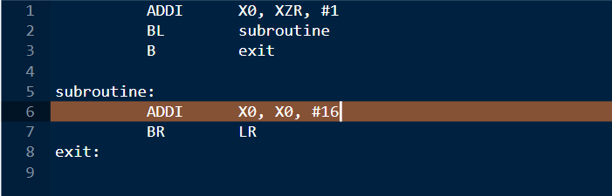
FIXING AND RESTORING THE SIMULATOR
THE BRANCH AND LINK BUG
WE SHOULD BE HERE!
IT DOESN'T GO BACK!

Slide 38
FIXING AND RESTORING THE SIMULATOR
ALL FIXED, BUT...
NOBODY KNOWS HOW IT WORKS!

Slide 39
FIXING AND RESTORING THE SIMULATOR
THE PROJECT'S DEPENDENCIES
GWT
AceGWT
THE SIMULATOR

Slide 40
FIXING AND RESTORING THE SIMULATOR
GWT
Framework (formerly) from Google
Generates web applications (client-server, client only) from Java
Emulates Java's JVM with JavaScript

Slide 41
FIXING AND RESTORING THE SIMULATOR
GWT
Old, outdated, barely supported
Convoluted custom build tools
Limited emulation of JVM
Basically needs Eclipse plug-in for real development

Slide 42
FIXING AND RESTORING THE SIMULATOR
AceGWT
Provides GWT bindings for the Ace editor
Can be used like normal GWT component
Also old, outdated, and unsupported

Slide 43
FIXING AND RESTORING THE SIMULATOR
WORKING IT OUT:
Needed older version of Eclipse, and Eclipse GWT plug-in
Reverse engineered the dependencies and their configuration
Configured build system to stop failing

Slide 44
FIXING AND RESTORING THE SIMULATOR
AFTER 3 YEARS, WE CAN NOW PRODUCE NEW VERSIONS OF THE SIMULATOR!

Slide 45
FILLING THE GAPS
Restoration and development of
Arm's Java-based LEGv8 ISA simulator​

Slide 46
FILLING THE GAPS
WHAT IS THE SIMULATOR MISSING?
Incomplete integer arithmetic
No visualization for the stack memory
No IEEE-754 arithmetic and data instructions

Slide 47
FILLING THE GAPS
THE MISSING INTEGER-BASED INSTRUCTIONS
MUL – LOWER 64 BITS OF THE MULTIPLICATION
SMULH – HIGHER 64 BITS OF THE SIGNED MULTIPLICATION
UMULH – HIGHER 64 BITS OF THE UNSIGNED MULTIPLICATION
SDIV – SIGNED DIVISION
UDIV – UNSIGNED DIVISION
LDA – LOAD ADDRESS OF A LABEL IN A REGISTER

Slide 48
FILLING THE GAPS
Easy to implement in the existing codebase
but...
Java doesn't like big or unsigned numbers!

Slide 49
FILLING THE GAPS
PROBLEM 1
Java does not have primitive 128-bit integer types
The BigInteger library exists
GWT 2.7 doesn't emulate it (2.8 does)

Slide 50
FILLING THE GAPS
PROBLEM 2
Primitive integers are signed
BigInteger also signed
Bitmask converts 64-bit unsigned integers to 65-bit signed, perform signed operations, back to unsigned

Slide 51
FILLING THE GAPS
STACK NOT VISUALIZED
Important for testing and debugging complex programs (now we can write them)
Useful to understand LEGv8 and stack management

Slide 52
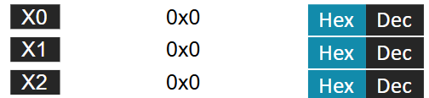
FILLING THE GAPS
TAKING SOME INSPIRATION

Slide 53
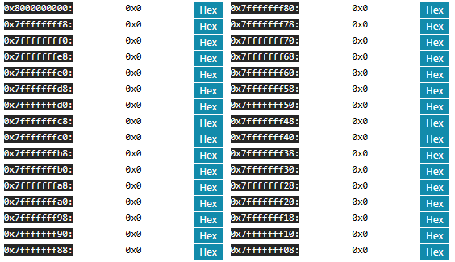
FILLING THE GAPS
THE NEW STACK VIEW

Slide 54
FILLING THE GAPS
ADDING FLOATING-POINT SUPPORT
FADDS, FADDD – ADD TWO IEEE-754 VALUES
FSUBS, FSUBD - SUBTRACT TWO IEEE-754 VALUES
FMULS, FMULD - MULTPLY TWO IEEE-754 VALUES
FDIVS, FDIVD – DIVIDE TWO IEEE-754 VALUES
LDURS, LDURD – LOAD IEEE-754 VALUE FROM MEMORY
STURS, STURD - STORE IEEE-754 VALUE TO MEMORY
FCMPS, FCMPD – COMPARE TWO IEEE-754 VALUES

Slide 55
FILLING THE GAPS
SIMULATOR NOT DESIGNED FOR FLOATING POINT
SOME STRUCTURAL CHANGES NEEDED (e.g. parser)

Slide 56

FILLING THE GAPS
ARITHMETICAL INSTRUCTIONS
Java's IEEE-754
LEGv8's IEEE-754

Slide 57
FILLING THE GAPS
MEMORY ACCESS INSTRUCTIONS
Simulator designed for integer use
Memory uses integers to store bytes

Slide 58
FILLING THE GAPS
IDEA: SEE INTEGERS LIKE RAW BITS
CONVERT FLOATS TO RAW BITS
CAN BE USED AS BINARY PROTOCOL
RETROCOMPATIBILITY!

Slide 59
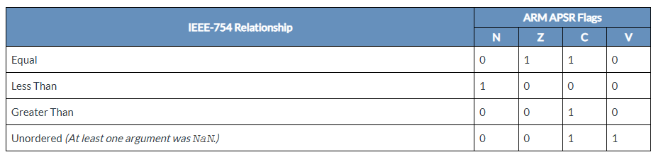
FILLING THE GAPS
COMPARISON INSTRUCTIONS
LEGv8 does not specify flag-setting conditions for IEEE-754 comparisons
Use ARMv8's ones:

Slide 60
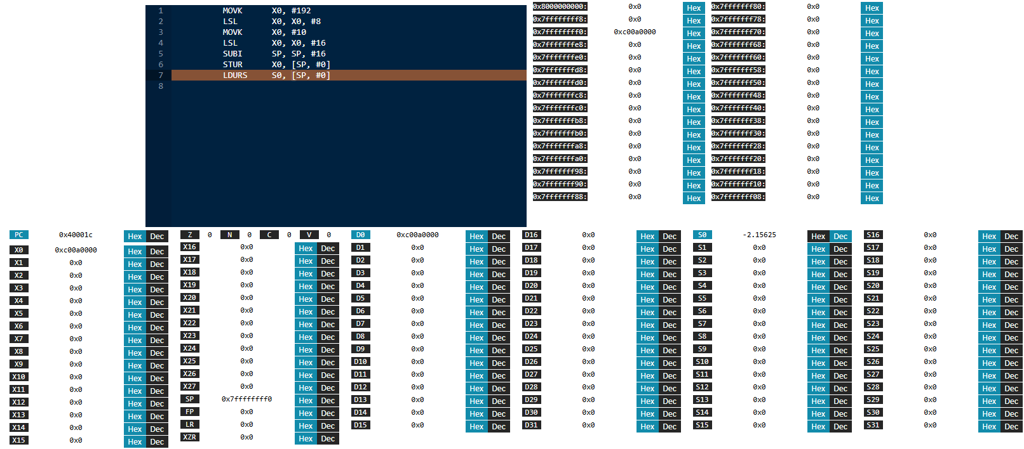
FILLING THE GAPS
THE FINAL VIEW

Slide 61
FILLING THE GAPS
THE CHERRY ON TOP: MODERNIZING THE BUILD SYSTEM

Slide 62
FILLING THE GAPS
WHY DO THIS?
Latest GWT and AceGWT support Maven
Much easier to include if project also supports Maven

Slide 63
FILLING THE GAPS
THE TRICKLE-DOWN EFFECT
Libraries are managed automatically
Project decoupled from Eclipse, can use other IDEs or even terminal
Can use Java 21, GWT 2.11
More configurable builds

Slide 64
CONCLUSIONS
Arm's LEGv8 simulator finally working
Only one to implement every LEGv8 instruction
Can now be developed with modern tools, set-up and build in seconds, much easier collaboration

Slide 65

THANK YOU FOR
YOUR ATTENTION
THESIS AVAILABLE HERE
SIMULATOR AVAILABLE HERE
: simdeistud

